Slide 1
Pneumonia Detection from Chest X Rays

Slide 2
Classifying Chest Xrays as Pneumonia or Normal
Dealing with Image data sets
Performing Data Preprocessing and augmentation as and when required
Creating and training a Convolutional Neural Network using Tensorflow 2.0.

Slide 3
Pre-requisites
Good Knowledge of Python programming language
In depth knowledge over linear and logistic regression
Understanding of basic image processing
Basic Understanding on artificial neural networks and convolutional neural networks working and implementation
Training a model will reduce the risk of human error

Slide 4
What is Pneumonia?
Pneumonia is an infection that inflames air sacs in one or both lungs infection can be life-threatening to anyone
The germs that cause pneumonia are contagious
Both viral and bacterial pneumonia can spread to others through:
Inhalation of airborne droplets from a sneeze or cough
By coming into contact with surfaces or objects that are contaminated with pneumonia-causing bacteria or viruses

Slide 5
Symptoms
Coughing that may produce mucus
Sweating or chills
Shortness of breath
Chest pain while breathing or coughing
Feeling of tiredness or fatigue
Loss of appetite
Nausea or vomiting
Headaches

Slide 6
Physical Check-Ups
Chest X-ray
Blood Culture
Sputum Culture
Pulse Oximetry
CT Scan
Fluid Sample
Bronchoscopy

Slide 7
Chest X-Rays related to Pneumonia disease
An X-ray exam allow a doctor to see lungs, heart and blood vessels etc to determine the presence of pneumonia
Infiltrates that identify an infection
Low contrast, overlapping organs and blurred boundary
Medical value and application significance to construct a stable and accurate automatic detecting model of pneumonia

Slide 8
Setup
To run a normal CPU, having a “CUDA” enabled GPU helps models get trained quicker.
‘Google’s Colaboratory’ is the developer’s best friend when it comes to deep learning.
Colaboratory is a Google research project created to help machine learning education and research.
Hosted on Google Cloud instances which we can use for free.

Slide 9
Tensorflow Dataset API
The tensorflow dataset API helps us in writing custom and efficient input pipelines.
Dataset API is used for:
Creating a Stacked object for Input data and labels
Applying transformations to the data
Iterating over the object to fetch the data

Slide 10
ResNets
It was the time when ‘AlexNet’ was released and people were just trying to build bigger and bigger networks.
Bigger networks were actually getting better accuracies but there was a limit and after that the errors went higher i.e. no improvement in performance.

Slide 11
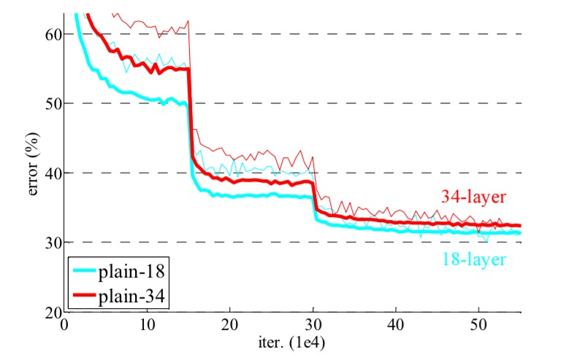
Issues using Plain Convolutional Networks
Validation errors for two plain convolutional networks
18 layers
34 layers
The error for a 34 layers network is higher as compared to 18 layers.

Slide 12
Issues using Pain Convolutional Netwroks
Adding more layers can lead to more complex learning functions which might lead to an overfitting situation.
Deeper networks might face an issue backpropagating the gradients, this issue is most commonly called the ‘Vanishing Gradients’ problem.

Slide 13
Solution
Overfitting can be handled using regularization and dropout where we deactivate few random neurons to help other neurons learn.
‘Vanishing Gradients’ problem can be handled using ‘ReLu’ activation which maximizes the gradient flow, we can use ‘Batch Normalization’ to address this issue as well.

Slide 14
ResNet Background
“A deep network should perform at least equal to its shallow counterparts.
Consider a Network where Initial layers are the shallow network and maintaining layers are Identity functions.”

Slide 15
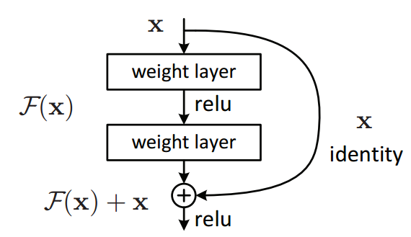
Residual Block
A residual block takes in the output of a layer and forwards the output to further layers.
It also remembers the past information which is nothing but the identity function.
This type of connection is also called “Skip connection”.

Slide 16
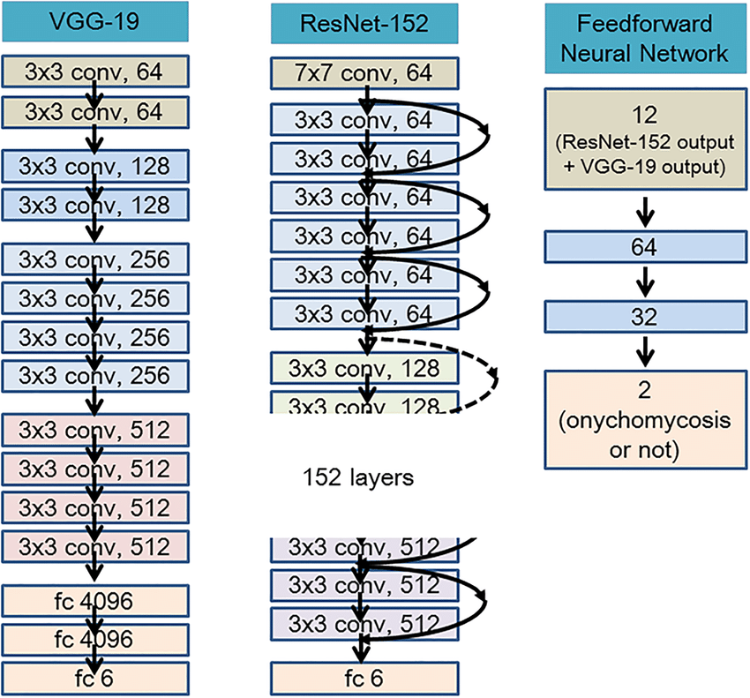
Deeper ResNet
They are very similar to each other except for the skip connections part.

Slide 17
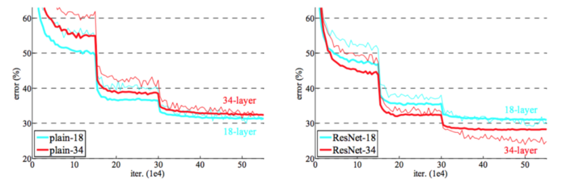
Plain Networks Vs ResNets

Slide 18
Plain Networks Vs ResNets
There is not much difference in validation errors of plain 18 layers and reset 18.
Difference starts showing up when we use deeper models like resnet 34 and resnet 50.
Validation error for 34 layer resnet is significantly lower as compared to its plain counterpart.
Difference will keep increasing with increase in number of layers.

Slide 19
Tensorflow Callback Object
A tensorflow callback object is used to perform an action in various stages of training process.
It could be at start or end of an epoch or step.
Earlystopping, Callback is used to stop the training process before our model tries to over learn the data i.e. overfitting. It takes in an argument called Patience.
Patience is the number of epoch(consecutive) with no improvement.

Slide 20
More Things to Try
Medical problem statements are complex and there’s a high chance to miss some important point before solving the issue.
X-ray scanners made by different companies do post processing in different ways.
Changes are huge in pixel level.
To improve the existing dataset by collecting X rays from multiple hospitals and different machines.

Slide 21
More Things to Try
We have used only 2 callbacks.
Like “LRScheduler” or “Reduce on Plateau” or build one custom callback.
We have ‘Inception’ networks ‘EfficientNets’ , ‘NasNets’.
We need to try out different models, compare the performance and then move forward with one of them.

Slide 22
Augmentation
Augmentation is the tricky part in medical imaging.
We cannot use more of the augmentations.
It might change the image itself.
To use augmentation which do not affect pixel values like horizontal rotations, random image cropping.
We could also try out blurring images in a minimal way.

Slide 23
Summary
Google Colab and GPUs.
Datasets consists of Images, Text and Videos.
To set up the environment for solving deep learning problems.
How to use tensorflow to build convolutional neural networks.
Identify and detect pneumonia from the chest x rays using the ResNet architecture.

